Slide 1
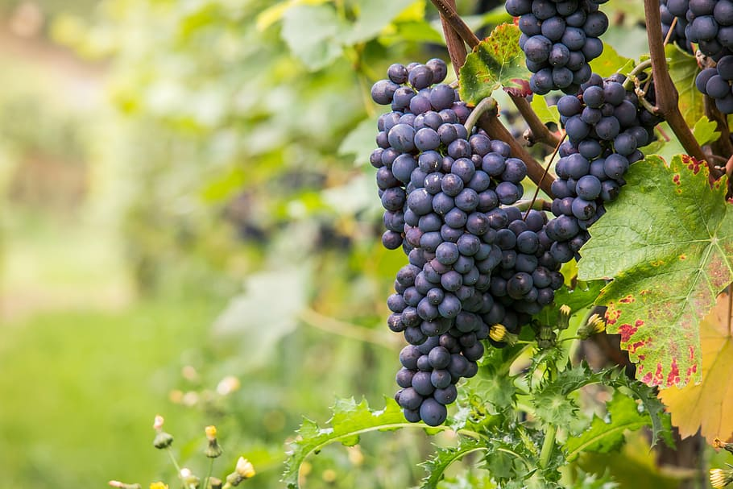
Becoming a Wine Enthusiast:
A Discussion of Quality in Red Vinho Verde Wines
Team Stark
Toyin Olaye, Camilla Inhapim, Jessica Hartman, Ramnath Gowrishankar, Matthew Copello, Luis Aguayo, Brooke Bentley

Slide 2
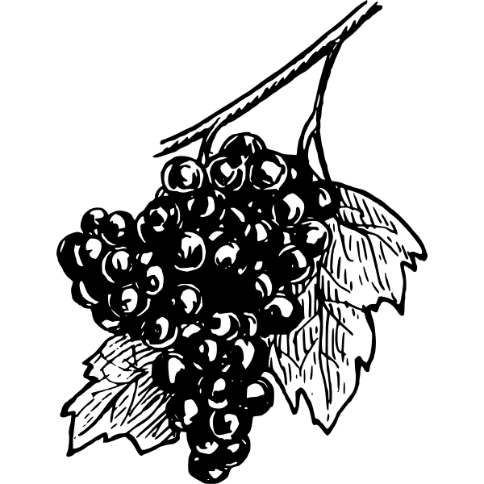
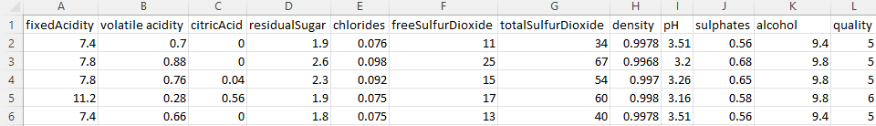
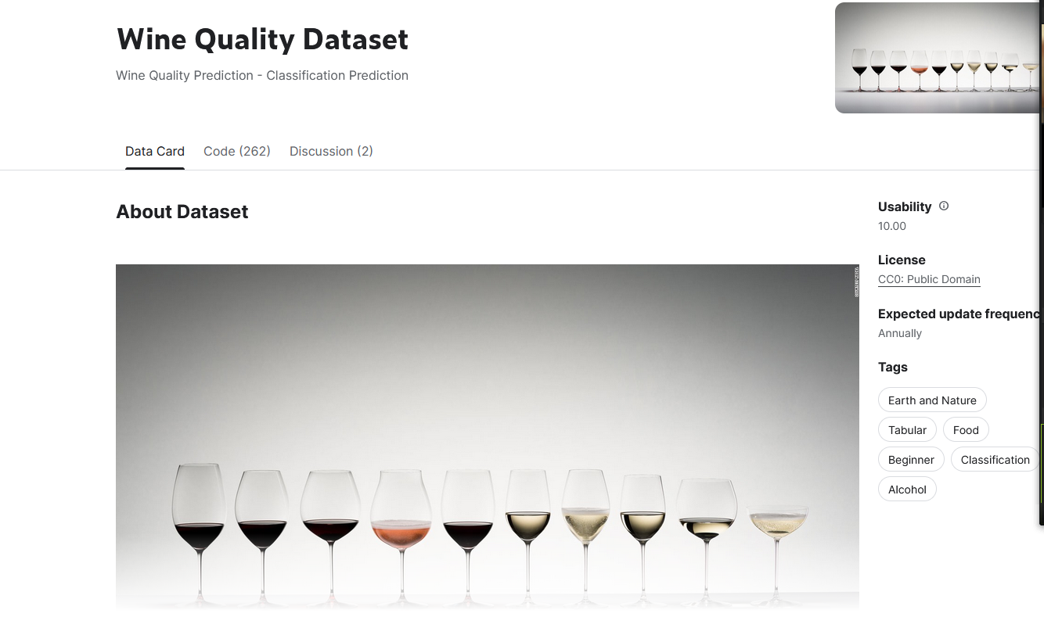
Data Sources
https://www.kaggle.com/datasets/yasserh/wine-quality-dataset
https://www.kaggle.com/datasets/uciml/red-wine-quality-cortez-et-al-2009

Slide 3

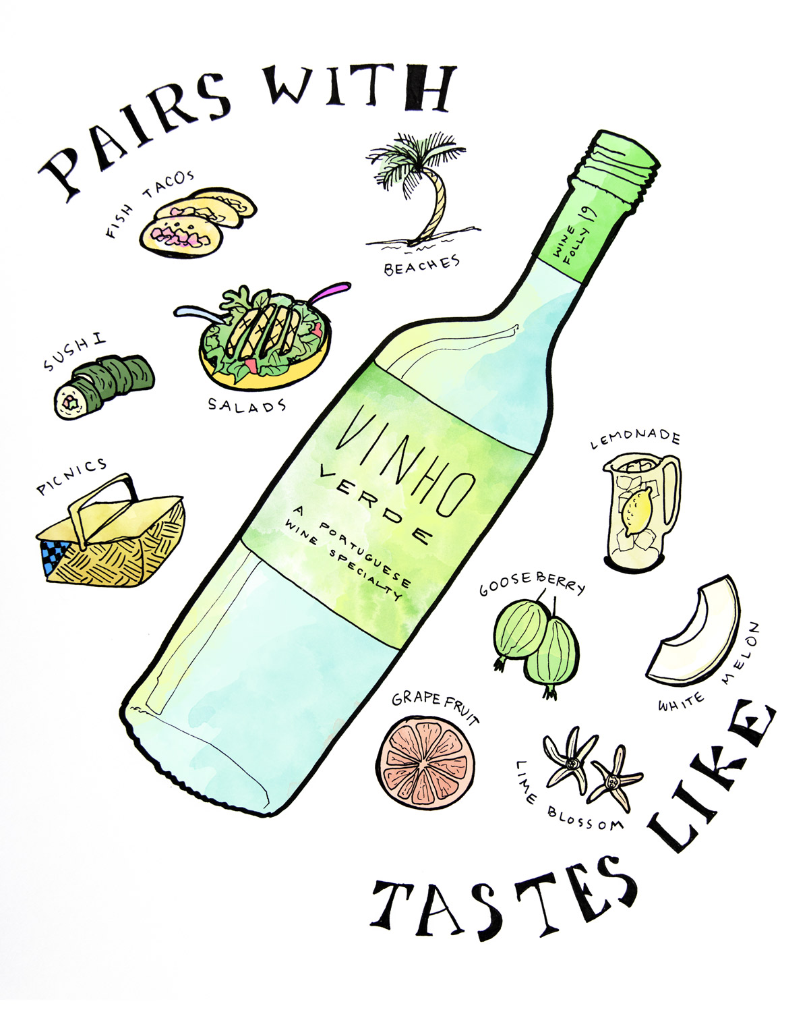
Datasets were created using red and white wine samples made exclusively from the Vinho Verde grape
Datasets contains:
“objective tests”
(e.g., pH values)
“subjective tests”
(sensory data from wine experts)
Notes:
Analyzing each feature
Good wines have different chemistry makeup than “bad” wine
Broad quality score, unlike previous models
**We all hear the ways people describe wines, fruity, sweet, etc, but what ona chemical basis makes a good/bad wine? We are looking to utilize a dataset that scientifically explored wine by testing for ph, various acidities, and sugars to predict the quality of the wine.**
Vihno Verde wines: objective measurements, collected from the same grape varietal but from different wines. Dataset is a combination of objective and subjective (quality)

Slide 4
Question: Restaurants are always looking for excellent wines to provide to their customers, but scientifically, what makes wine higher or lower in quality?
Solution: We leveraged a dataset containing objective (physiochemical test) feature data to investigate wine quality & implement a Random Forest Model tool. By using this tool, we can input various physicochemical values and output predicted wine quality.
End User inputs: Acidity, pH, Residual Sugars, Density
End User Returns: Number between 0 (very bad) and 10 (very excellent)
Notes:
Analyzing each feature
Good wines have different chemistry makeup than “bad” wine
Broad quality score, unlike previous models
**We all hear the ways people describe wines, fruity, sweet, etc, but what ona chemical basis makes a good/bad wine? We are looking to utilize a dataset that scientifically explored wine by testing for ph, various acidities, and sugars to predict the quality of the wine.**
Vihno Verde wines: objective measurements, collected from the same grape varietal but from different wines. Dataset is a combination of objective and subjective (quality)

Slide 5
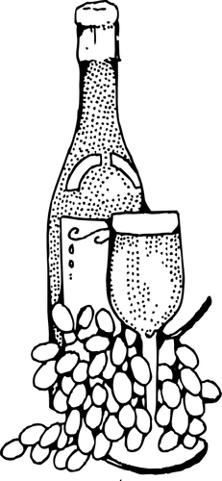
Wine Chemistry Background
pH:
The lower the pH the more acidic the wine will be. Wines high in acidity tend to taste more dry than wines low in acidity.
Typically, white wines contain a lower pH than red wines.
Alcohol Content
In general, red wines have a higher ABV value than white wines.
Residual Sugars:
Leftover sugars from the natural grape after the fermentation process.
Chlorides
Adds to the saltiness of the wine
Sulphites
Needed for shelf life - often believed to contribute to hangovers
Quality Score: A scale of 0 - 10

Slide 6
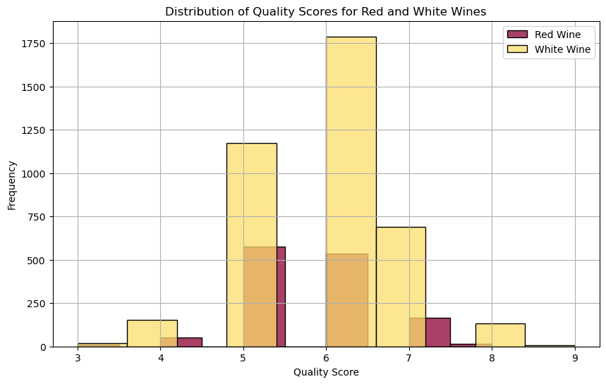
Red and white wines tend to receive mostly mid-tier Quality Scores being between 5 and 6.
Disclaimer: the dataset has 1599 rows of data for red wine while white wine has 4898 rows.

Slide 7
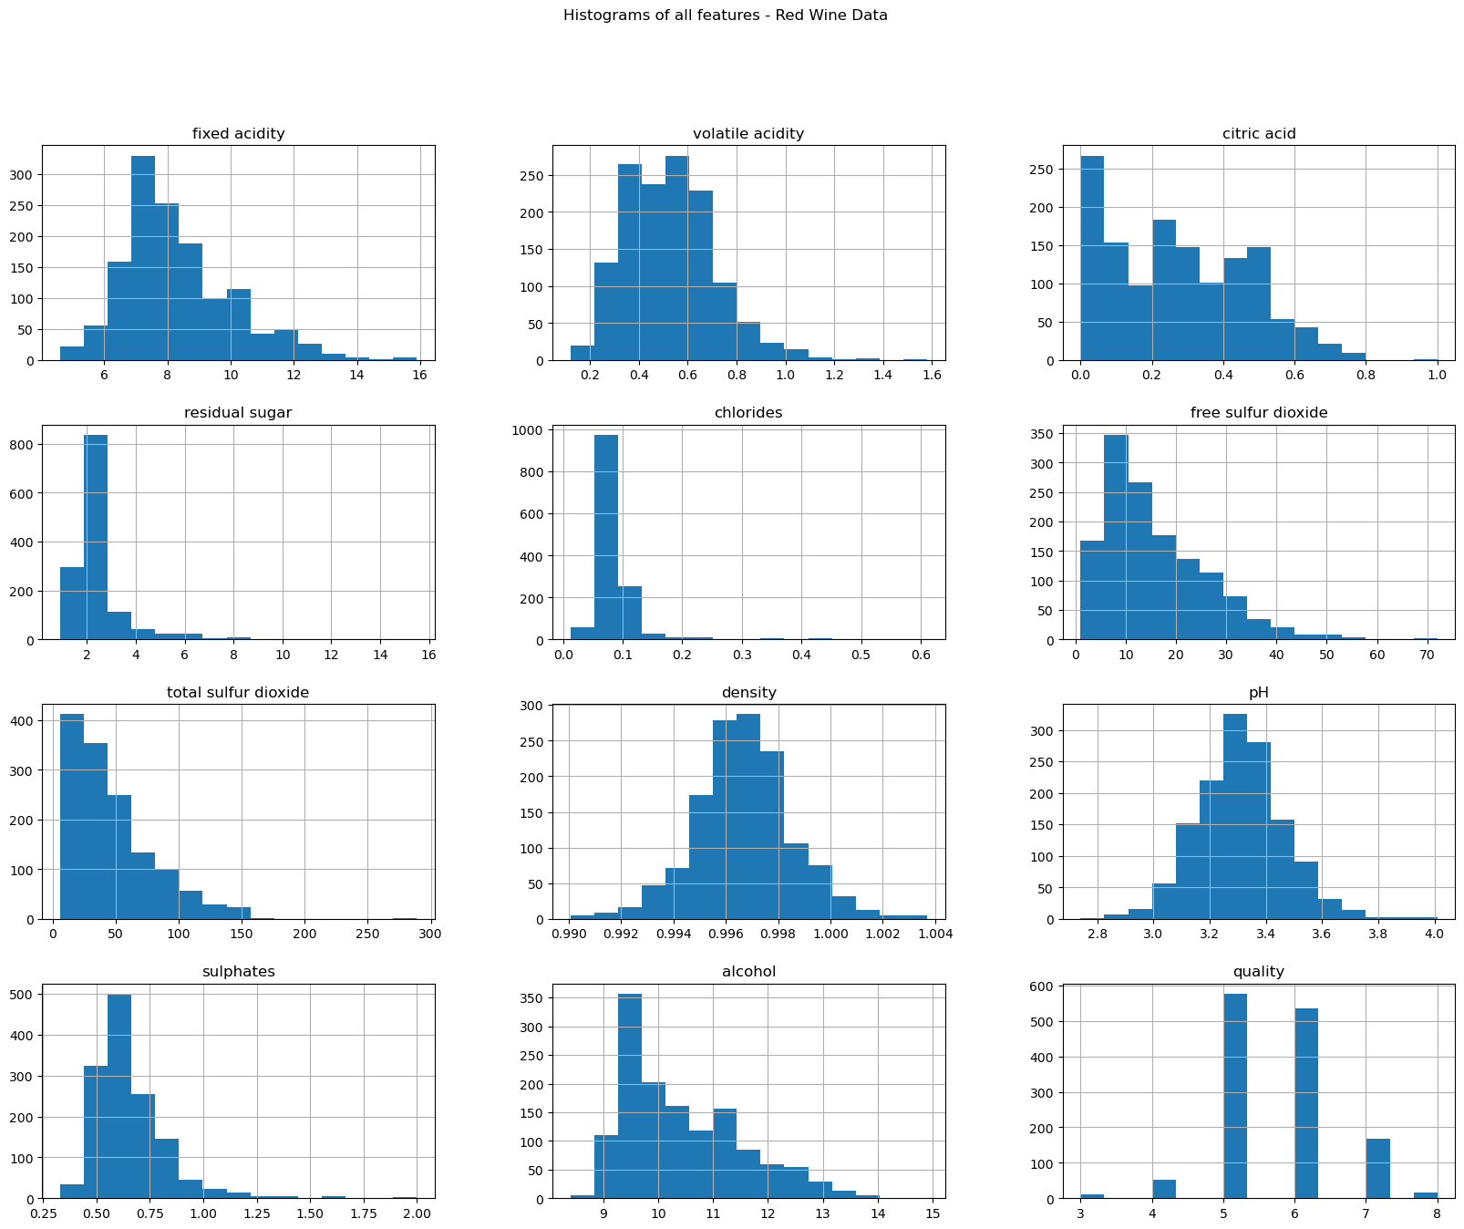
Histograms of all features: Red Wine
Histogram allows us to see the range of all the red and white wines
In terms of quality it is rated on a scale of 0-10.
x-axis = feature value | y-axis= frequency of each value

Slide 8
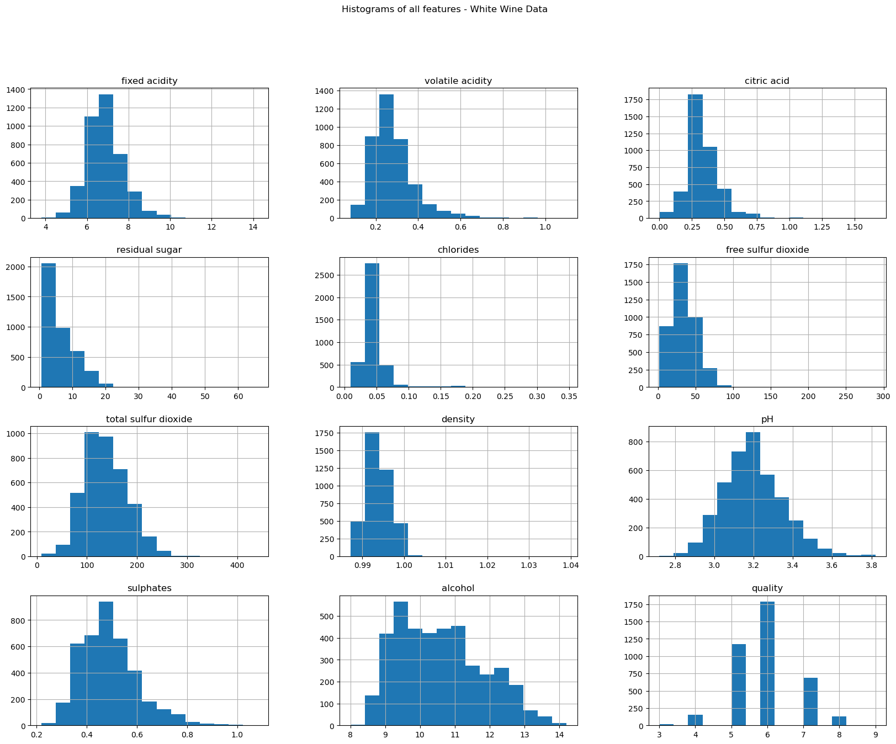
Histograms of all features: White Wine
We are limited by our data set because of the lack of diversity in the quality of wine
Neither red or white wines are rated a 10. The highest rating being white wine.
Notes:
Distribution of all features

Slide 9
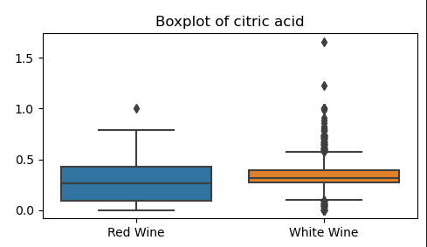
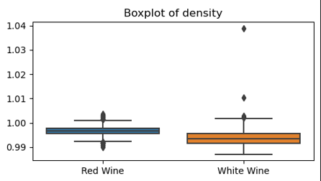
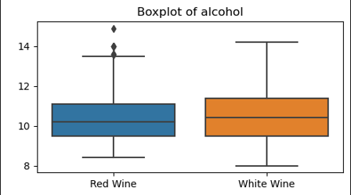
There is little to no variety in terms of bad, decent and good wine. All around the middle of the ranges they are mediocre
We noticed that generally with higher ABV. the higher the quality of the wine.
Notes:
Describe limitation with the data - not a lot of variety. Don’t have dataset that has good, bad and decent wines. No wines are rated a 10 in either dataset. White wine has 9 score
Machine learning- higher quality = higher abv

Slide 10
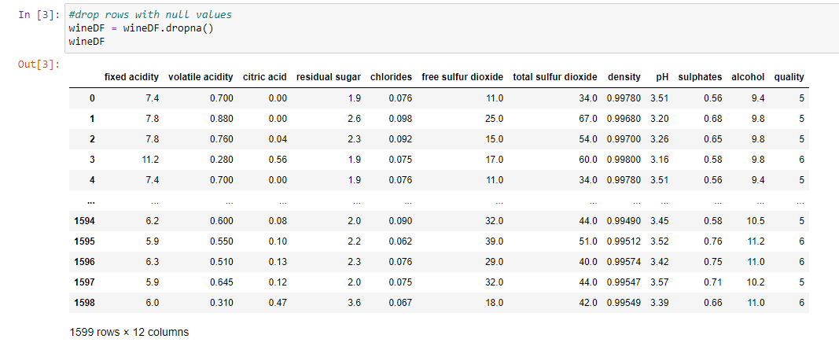
Machine Learning
Step 1: Preprocessing

Slide 11
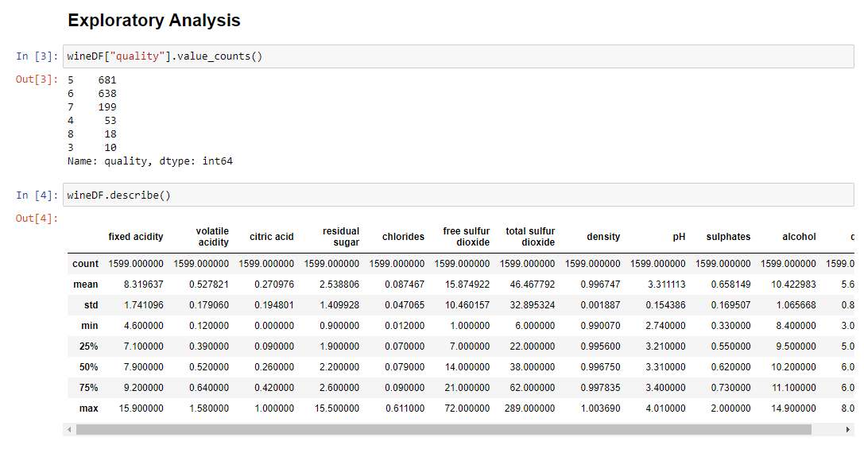
Machine Learning
Step 2: Exploratory Data analysis

Slide 12
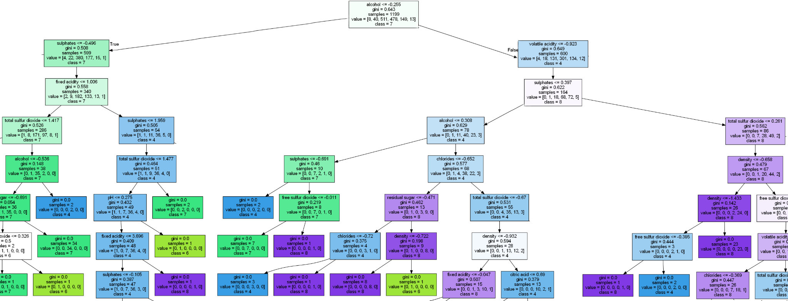
Machine Learning
Step 3: Choosing a Model: Random Forest Model
Step 4: Training and Testing

Slide 13
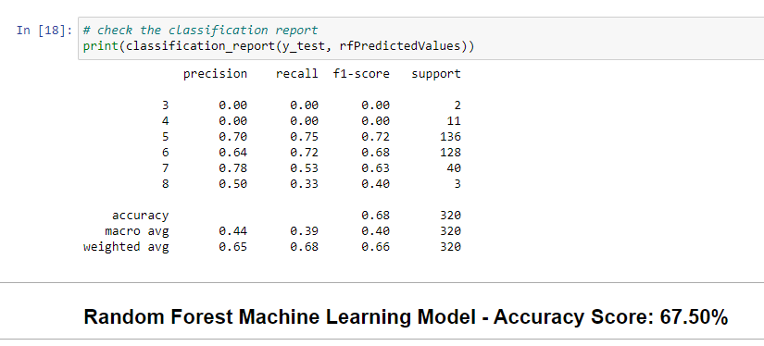
Machine Learning
Step 5: Evaluating the Model: 67.50% Red Wine

Slide 14
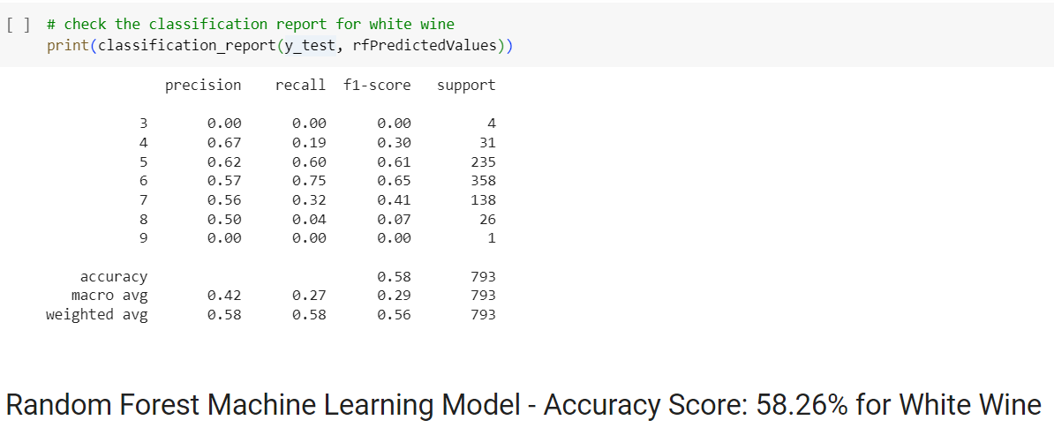
Machine Learning
Step 5 Cont.: Evaluating the Model: 58.26% White Wine

Slide 15
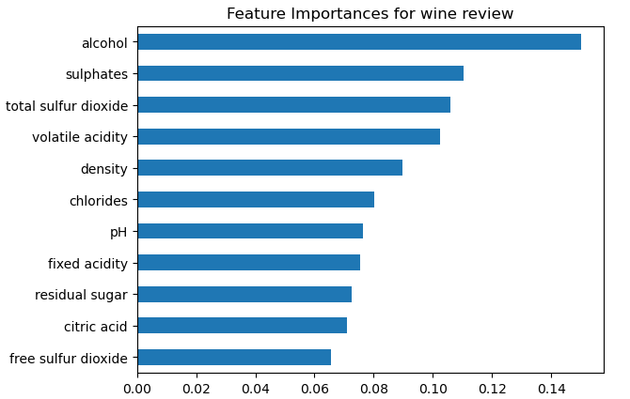
Machine Learning
Step 6: Feature Importances for Red Wine

Slide 16
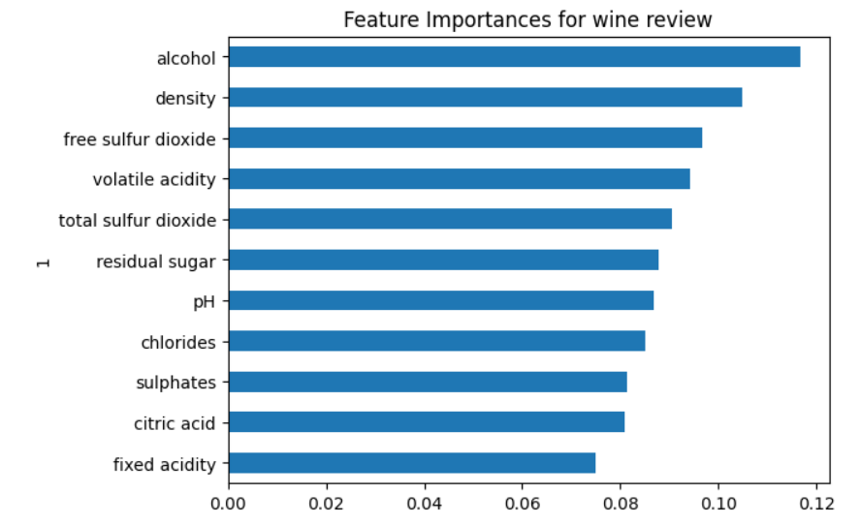
Machine Learning
Step 7 Cont.: Feature Importances for White Wine

Slide 17
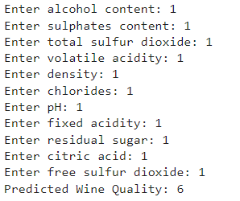
Machine Learning
Step 8: Making Predictions: User Prompt

Slide 18
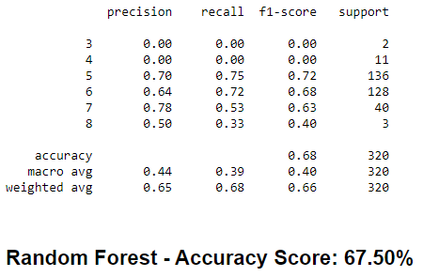
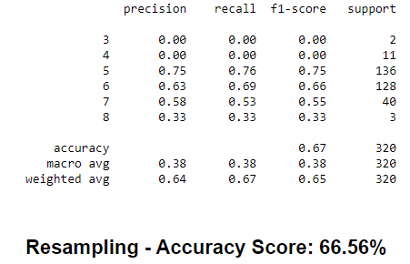
Machine Learning
Step 9: Resampling

Slide 19
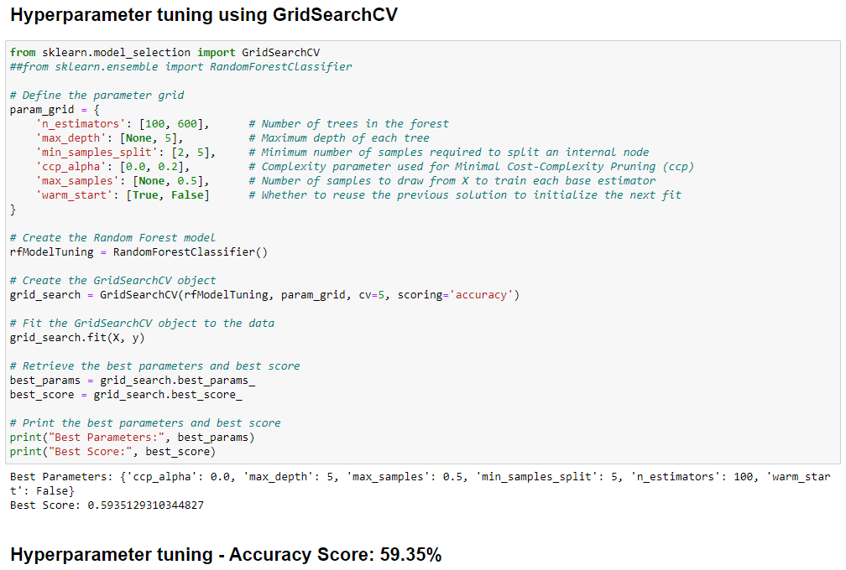
Machine Learning
Step 10: Hyperparameter tuning:
GridSearchCV

Slide 20
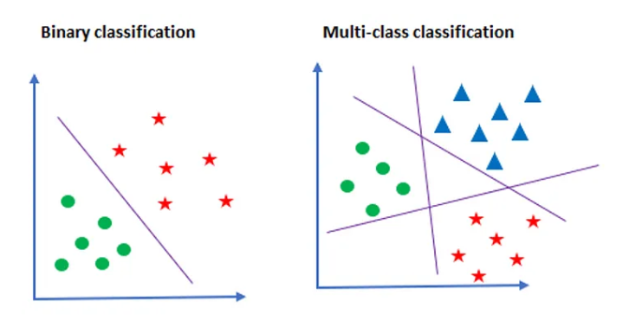
Machine Learning
Conclusions:
Baseline accuracy:
93% for a binary classification
Binary x MultiClassification
Parameter Tuning:
Dataset imbalanced: subjectiveness of ratings
Initial values were more efficient
Overfitting

Slide 21

Want to become a wine enthusiast?
Click here
Cheers!

Slide 22
Resources
https://www.kaggle.com/datasets/yasserh/wine-quality-dataset
https://www.kaggle.com/code/samarpanpandey/red-wine-quality-extensive-eda-linear-rf#Data-Modeling
https://www.kaggle.com/code/navdeepjakhar/red-wine-quality-prediction#Best-performing-model
https://www.kaggle.com/code/samarpanpandey/red-wine-quality-extensive-eda-linear-rf#Data-Modeling
https://www.kaggle.com/code/navdeepjakhar/red-wine-quality-prediction#Best-performing-model
Wine Chemistry Facts:
https://winefolly.com/deep-dive/understanding-acidity-in-wine/
https://winefolly.com/tips/wine-sweetness-chart/

